Slide 1
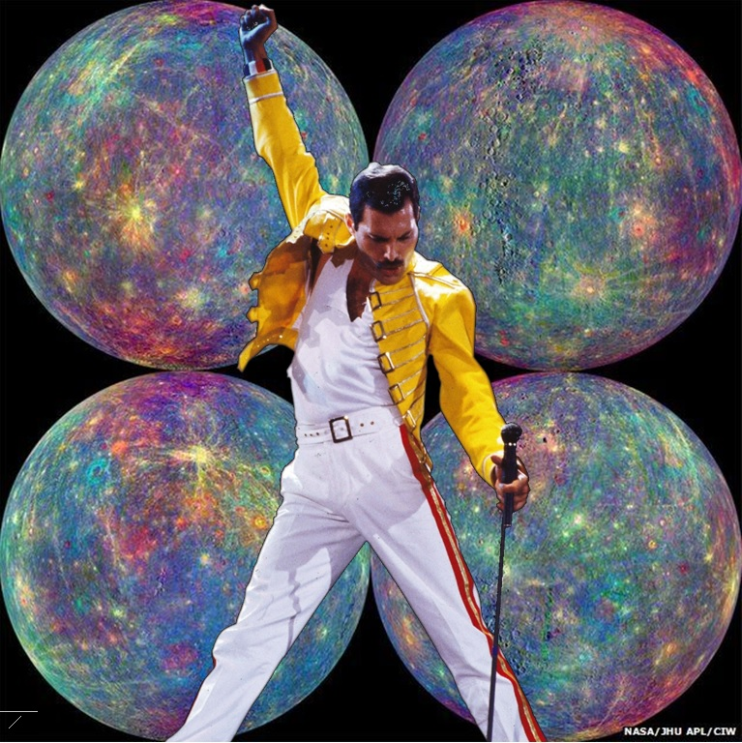
A song about my PhD
Sofia Qvarfort

Slide 2
Is this PhD life?
Is this just fantasy?

Slide 3
To use quantum systems
As sensors for gravity?

Slide 4
Take laser light
Point it at a sphere and see

Slide 5
It’s optomechanics!
And now add gravity

Slide 6
But the dynamics is
hard to solve
System they must time-evolve!

Slide 7
And the way we measure
Really really matters to me
to me

Slide 8
Professor, I’m so confused

Slide 9
These results cannot be true
There’s an extra factor of two!

Slide 10
Professor, can I publish this?
I hope I’ll get a really good review!

Slide 11
Quantum, ooh

Slide 12
Commutators make me cry!
And I can’t add the noise into my models!

Slide 13
But I carry on, carry on
As if my PhD really mattered…

Slide 14
Fisher information
Gives the variance

Slide 15
Of a gravity measurement
Add some values, you’re all set

Slide 16
Quantum metrology
Gives us the bounds

Slide 17
Gotta calculate them all and find the truth!

Slide 18
Quantum, ooh

Slide 19
I get some decent bounds
But would it work experimentally at all?

Slide 20
I see a cubic Hamiltonian we can solve

Slide 21
Linear force, linear force
It becomes a potential!

Slide 22
Algebras and writing
Very very enlightening me!

Slide 23
Quantum systems
Quantum systems

Slide 24
How to quantise I don’t know!

Slide 25
Light and mechanics, they will entangle

Slide 26
Gravity enters as a phase into the light state

Slide 27
The system decouples after one period

Slide 28
(Inset Freddie Mercury being awesome)

Slide 29
This research really sets the world alight for me
For me
For me

Slide 30
So I’ve written a paper and it’s on the arXiv!

Slide 31
I’ve got some results and they’re pretty air-tight!

Slide 32
Ooh, science!
I just love doing science!

Slide 33
I just wanna stay
Just wanna stay in academia

Slide 34
To publish and to flourish
So for my PhD

Slide 35
I tried to understand
How to measure gravity

Slide 36
(I’m going to hand in my thesis now…!)

